Slide 1
Spanish for medical students fostering collaborative learning in mixed-level groups
Lucy Hill (lucy.hill@ncl.ac.uk)
School of Modern Languages

Slide 2
e-learning symposium 2013
4th year Medical students
Guided learning
Elective placements in Spanish speaking countries
Autonomous work
Learn the language
Online resources
Collaborative environment

Slide 3
Medical Spanish SSC
General Information
This an intensive six week course of general & Medical Spanish suitable for those with an interest in learning Spanish from scratch or extending existing knowledge.

Slide 4
The learners
Intelligent
Beginners
Hard working
GCSE level
As level
Very competitive
A level
Going to Spanish speaking country for their elective
very motivated to learn Spanish

Slide 5
Preliminary information from the students
1. Your name
2. Your current knowledge of Spanish: Have you studied Spanish at all? If you have, what is your approximate level? Please provide details of any formal qualifications / language courses attended / visits to Spanish speaking countries etc.
3. Why do you want to do this course?
4. What do you expect from the course?

Slide 6
Induction session
Beginners/GCSE Level
Direct instruction
As /A level.
Text book for everyday Spanish.
Booklet for Medical Spanish.
Lessons.
Lots of homework.
A session with an assistant.
Peer collaborative work.
Syllabus.
They will work together as a group mostly without a teacher.
They will have 20 minutes session a week with the language assistant.
They will help each other, it will be a collaborative environment.
They will work individually in pairs and in groups.

Slide 7
The learner role
Learners are directors of their own learning.
Choose their own learning outcomes
They must plan and organise their time
Be responsible for their own learning
Reflect on their own learning, record their aims and experiences, their progress and their achievements for their e-portfolio
Help each other to achieve their goals
Work on their own and be part of a team

Slide 8
Time-table. Booking classrooms for both groups.
Plan and structure course. Give detailed syllabus in paper and BB.
Register students in BB. Let them know where the learning resources are.
Teacher’s role
Attend some of their presentation sessions. Teach when needed.
Mark & keep a record of their work and weekly progress.
Give them support and constructive feedback.

Slide 9
Medical Spanish
1. Introduction and patient
3. Disease based
questions
2. Anatomical terms and complaints
4. Physical exam
5. Treatment and discharge

Slide 10
Vocabulary
Tasks:
Learn parts of the body & illnesses/ vocabulary that they don’t know in everyday situations, etc.
They can use Internet websites such as):
Every day Spanish
1 2 3 4
Parts of the body
1 2 3 4
Medical role plays
Medical History

Slide 11
Grammar
Tasks:
For this session, following the syllabus the students will have very clear the grammar points they need to cover.
Grammar
Conjugations
Language box

Slide 12
Listening and speaking
Watch the program
Take notes
Present it to the group
Get constructive feedback from the group
Write down a summary to be marked by the teacher
La mañana de la 1

Slide 13
Reading comprehension/speaking
Choose two illnesses per day
Learn about the condition, causes, diagnosis and treatment
Present the illness to their group without reading
Take part in a role play where one is the doctor and the other one is the patient
Take notes of their partners presentations and be ready to give constructive feedback
Interactive tutorials. Introduction,
Symptoms, causes, diagnosis, treatments
Noticias médicas

Slide 14
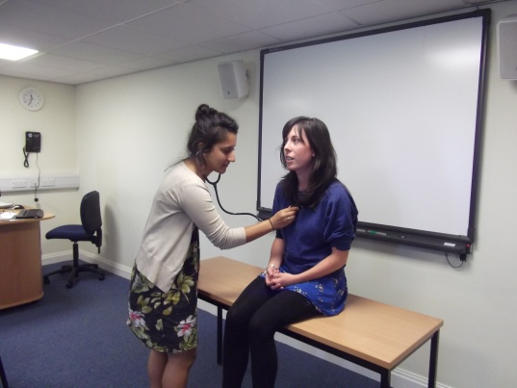
Assessment
At the end of the course you need to:
Part one: 20 minutes:
Take part in a role play with your teacher. You will be the doctor and your teacher will be the patient. (10 minutes).
Give a presentation to your teacher on one of the studied illnesses.
Write down the history for your patient.
Part 2: (2 hours)
Written exam: includes reading comprehension/ listening/ writing/ grammar.
Part 3 (10 minutes)
A presentation to the group of a topic of your own.
Part 4 (20 minutes)
A role play where you are the patient and your friend is the doctor.
+ e-portfolio

Slide 15
Marking criteria
In course assessment form
E-Portfolio assessment form
Merit
Satisfactory
Borderline
Unsatisfactory

Slide 16
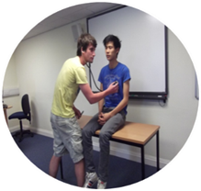
Overall rating for this module (out of 5)
2009/2010
2010/2011
2011/2012
4.9
4.7
4.8
I enjoyed how much a challenge the expected outcomes were as it made me try really hard.
The structure was good and allowed us to manage our own work well as well as having lessons.
I now feel completely comfortable talking to a patient in Spanish and carrying out a consultation for my elective, thanks to sufficient practice in listening and speaking over the 6 weeks.

